Slide 1


Developing
Go-Mart Application
Unveil the power of the .NET Framework with the Developing Go-Mart Application, a robust Windows application that seamlessly integrates C# and Microsoft SQL Server. Embark on a journey to streamline your business operations and deliver a exceptional user experience.
by Gaurav Suryavanshi

Slide 2

Introduction to .NET Framework
The .NET Framework is a software framework developed by Microsoft that provides a runtime environment and a comprehensive set of libraries, APIs, and tools for building Windows applications.
It is a crucial component in Windows application development, enabling developers to create robust, secure, and scalable desktop programs with features like graphical user interfaces, data access, and network connectivity.
The .NET Framework's key components, such as the Common Language Runtime (CLR) and the Base Class Library (BCL), provide a unified programming model and abstraction layer, making it easier for developers to build, deploy, and maintain Windows applications.

Slide 3
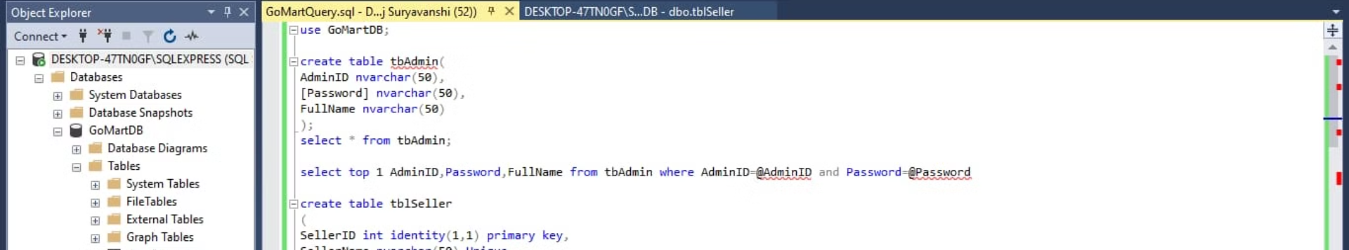
Key Components
C# Programming Language
MSSQL Server
Windows Forms
A powerful relational database management system that provides secure and scalable data storage and management for the Go-Mart application.
A UI framework for creating desktop applications on the Windows platform. Windows Forms enables the design of intuitive and responsive user interfaces.
A powerful and versatile programming language used for building robust Windows applications. C# offers a rich set of features and tools for efficient development.

Slide 4

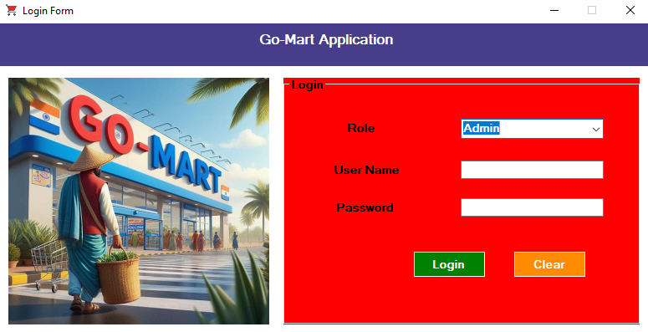
Login Form
The Login Form serves as the entry point for both administrators and sellers to access the Go-Mart application. It provides a secure authentication mechanism to ensure only authorized users can gain access to the system.
The Login Form is designed using Windows Forms, providing a clean and intuitive user interface. Users can input their credentials, which are then validated against the MSSQL Server database for proper authentication.

Slide 5
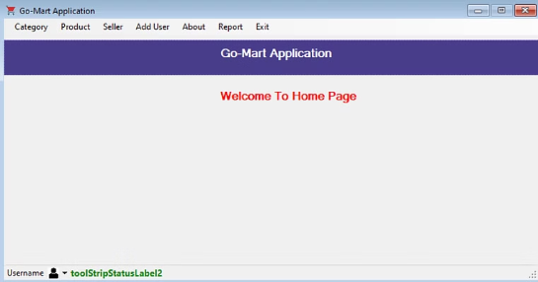
Homepage
Category
Product
Add User
About, Report, Exit
The homepage features a category section, allowing users to easily browse and navigate through different product categories.
The homepage prominently displays the available products, making it easy for users to find and purchase the items they need.
The homepage includes an option to add new users, enabling the application to manage and track user accounts.
The homepage provides access to the About section, reporting functionality, and the ability to exit the application, ensuring a comprehensive user experience.

Slide 6
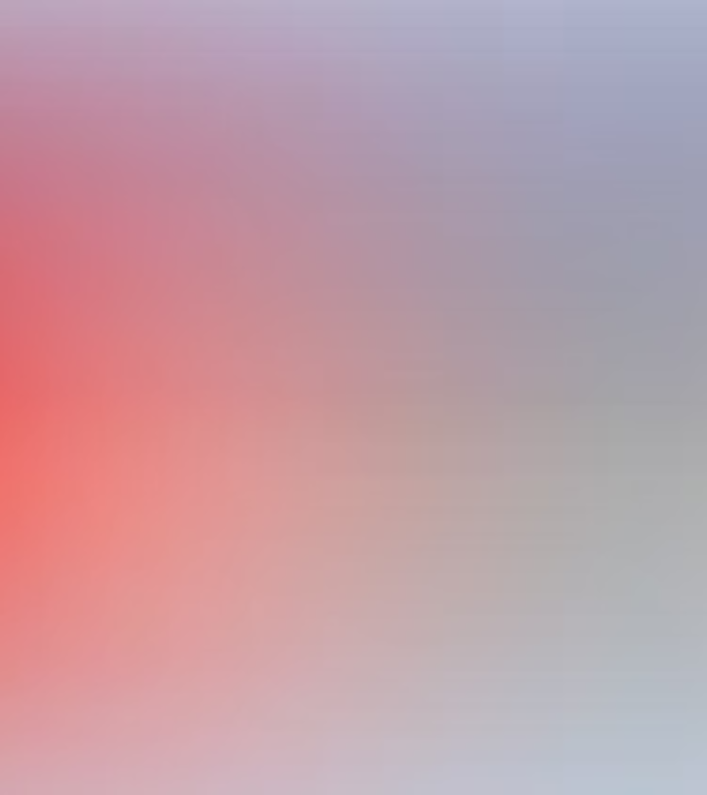
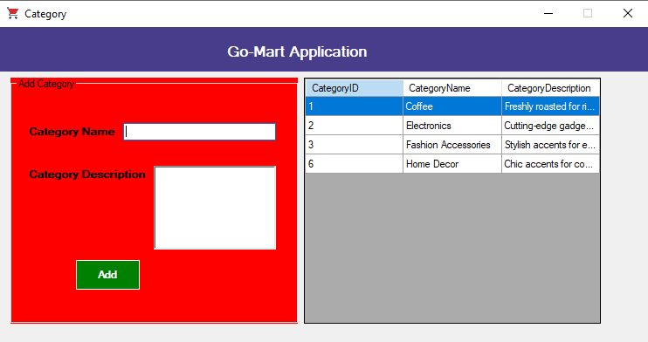
Category Form
The Category Form serves as the central hub for managing product categories within the Go-Mart application. This feature allows users to effortlessly add new categories, update existing ones, and even delete outdated categories as needed.
The implementation involves intuitive user interface controls, seamless integration with the MSSQL Server database, and robust validation to ensure data integrity. With this powerful tool, the Go-Mart team can keep the product catalog organized and up-to-date, enhancing the overall user experience.

Slide 7

Managing Items
Add Items
1
Users can easily add new items to the inventory system. This involves inputting product details like name, description, price, and quantity.
2
Update Items
Administrators have the ability to modify existing item details, such as updating product information or adjusting pricing and stock levels.
Delete Items
3
When an item is no longer sold or needs to be removed, users with proper permissions can delete the item from the database.

Slide 8

Adding Product & Seller
The application provides functionality to easily add new products and sellers. The intuitive interface allows users to input all the necessary details, including product descriptions, pricing, and seller information.
The data is securely integrated with the MSSQL Server database, ensuring efficient storage and retrieval of product and seller details. This empowers the application to maintain a comprehensive catalog of available items and associated sellers.

Slide 9
Conclusion
1
Recap of Key Points
2
Future Scope and Enhancements
We've explored the development of the Go-Mart application, highlighting its core features built on the .NET Framework, C#, and MSSQL Server. The application offers robust user authentication, category management, and comprehensive product and seller data management.
Moving forward, the Go-Mart application could be expanded with advanced analytics, reporting capabilities, and integration with e-commerce platforms to enhance the overall user experience and business insights.

Slide 10

Thank You
Thank you all for your time and attention today. We've covered a lot of ground on the development of the Go-Mart application, from the .NET Framework and key components to the detailed features and functionality. We hope this presentation has provided valuable insights into our vision for this exciting new Windows application.

